Slide 1
Computer Security
The NIST Computer Security Handbook defines the term computer security as:
“The protection afforded to an automated information system in order to attain the applicable objectives of preserving the integrity, availability, and confidentiality of information system resources (includes hardware, software, firmware, information/data, and telecommunications)”
NIST: National Institute of Standards and Technology
This definition introduces three key objectives that are at the heart of computer security.

Slide 2
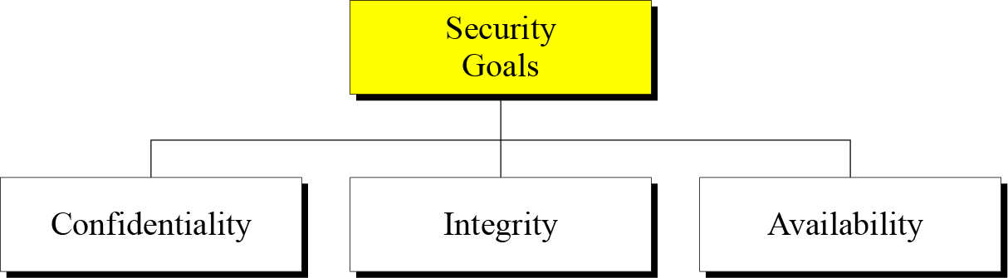

Slide 3
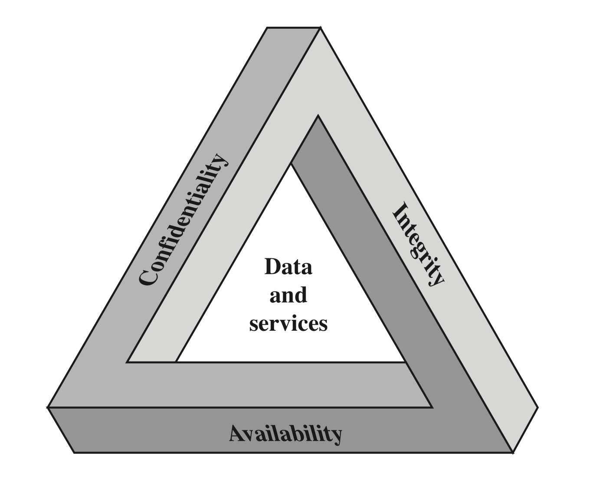
CIA Triad
The Security Requirements Triad

Slide 4
Confidentiality is probably the most common aspect of information security. We need to protect our confidential information. An organization needs to guard against those malicious actions that endanger the confidentiality of its information.
Integrity : Information needs to be changed constantly. Integrity means that changes need to be done only by authorized entities and through authorized mechanisms.
Availability : The information created and stored by an organization needs to be available to authorized entities. Information needs to be constantly changed, which means it must be accessible to authorized entities.

Slide 5
Computer Security Objectives
Confidentiality
Data confidentiality
Assures that private or confidential information is not made available or disclosed to unauthorized individuals
Privacy
Assures that individuals control or influence what information related to them may be collected and stored and by whom and to whom that information may be disclosed
Availability
Assures that systems work promptly and service is not denied to authorized users

Slide 6
Integrity
Data integrity
Assures that information and programs are changed only in a specified and authorized manner
System integrity
Assures that a system performs its intended function in an unimpaired manner, free from deliberate or inadvertent unauthorized manipulation of the system

Slide 7
Examples of Security Requirements
Confidentiality
Student grade information is an asset whose confidentiality is considered to be highly important by students
Regulated by the Family Educational Rights and Privacy Act (FERPA)
Integrity
(consistency)
Patient information stored in a database – inaccurate information could result in serious harm or death to a patient and expose the hospital to massive liability
A Web site that offers a forum to registered users to discuss some specific topic would be assigned a moderate level of integrity
An example of a low-integrity requirement is an anonymous online poll
Availability
The more critical a component or service, the higher the level of availability required
A moderate availability requirement is a public Web site for a university
An online telephone directory lookup application would be classified as a low-availability requirement
Notes:
Confidentiality
Student grade information is an asset whose confidentiality is
considered to be highly important by students. In the United States, the release of
such information is regulated by the Family Educational Rights and Privacy Act
(FERPA). Grade information should only be available to students, their parents,
and employees that require the information to do their job. Student enrollment
information may have a moderate confidentiality rating. While still covered by
FERPA, this information is seen by more people on a daily basis, is less likely to be
targeted than grade information, and results in less damage if disclosed. Directory
information (such as lists of students, faculty, or departmental lists) may be assigned
a low confidentiality rating or indeed no rating. This information is typically freely
available to the public and published on a school’s Web site.
Integrity
Several aspects of integrity are illustrated by the example of a hospital
patient’s allergy information stored in a database. The doctor should be able to
trust that the information is correct and current. Now suppose that an employee
(e.g., a nurse) who is authorized to view and update this information deliberately
falsifies the data to cause harm to the hospital. The database needs to be restored
to a trusted basis quickly, and it should be possible to trace the error back to the
person responsible. Patient allergy information is an example of an asset with a high
requirement for integrity. Inaccurate information could result in serious harm or
death to a patient and expose the hospital to massive liability.
An example of an asset that may be assigned a moderate level of integrity
requirement is a Web site that offers a forum to registered users to discuss some
specific topic. Either a registered user or a hacker could falsify some entries or deface
the Web site. If the forum exists only for the enjoyment of the users, brings
in little or no advertising revenue, and is not used for something important such
as research, then potential damage is not severe. The Web master may experience
some data, financial, and time loss.
An example of a low-integrity requirement is an anonymous online poll. Many
Web sites, such as news organizations, offer these polls to their users with very few
safeguards. However, the inaccuracy and unscientific nature of such polls are well
understood.
Availability
The more critical a component or service, the higher is the level of
availability required. Consider a system that provides authentication services for
critical systems, applications, and devices. An interruption of service results in the
inability for customers to access computing resources and for the staff to access
the resources they need to perform critical tasks. The loss of the service translates
into a large financial loss due to lost employee productivity and potential
customer loss.
An example of an asset that typically would be rated as having a moderate
availability requirement is a public Web site for a university; the Web site provides
information for current and prospective students and donors. Such a site is not a
critical component of the university’s information system, but its unavailability will
cause some embarrassment.
An online telephone directory lookup application would be classified as a low availability
requirement. Although the temporary loss of the application may be
an annoyance, there are other ways to access the information, such as a hardcopy
directory or the operator.

Slide 8
Possible additional concepts:
Authenticity
Verifying that users are who they say they are and that each input arriving at the system came from a trusted source
Accountability
The security goal that generates the requirement for actions of an entity to be traced uniquely to that entity

Slide 9
Breach of Security 3 Levels of Impact
High
The loss could be expected to have a severe or catastrophic adverse effect on organizational operations, organizational assets, or individuals
Moderate
The loss could be expected to have a serious adverse effect on organizational operations, organizational assets, or individuals
Low
The loss could be expected to have a limited adverse effect on organizational operations, organizational assets, or individuals

Slide 10
X.800
X.800 Recommendation:
1. provides a general description of security services and related mechanisms, which may be provided by the Reference Model; and
2. defines the positions within the Reference Model where the services and mechanisms may be provided.
This Recommendation extends the field of application of recommendation X.200, to cover secure communications between open systems.

Slide 11
OSI Security Architecture
ITU-T Recommendation X.800, Security Architecture for OSI describes a systematic way of defining the requirements for security and characterizing the approaches to satisfying those requirements. Focus
Security attack
Any action that compromises the security of information owned by an organization
Security mechanism
A process (or a device incorporating such a process) that is designed to detect, prevent, or recover from a security attack
Security service
A processing or communication service that enhances the security of the data processing systems and the information transfers of an organization
Intended to counter security attacks, and they make use of one or more security mechanisms to provide the service

Slide 12
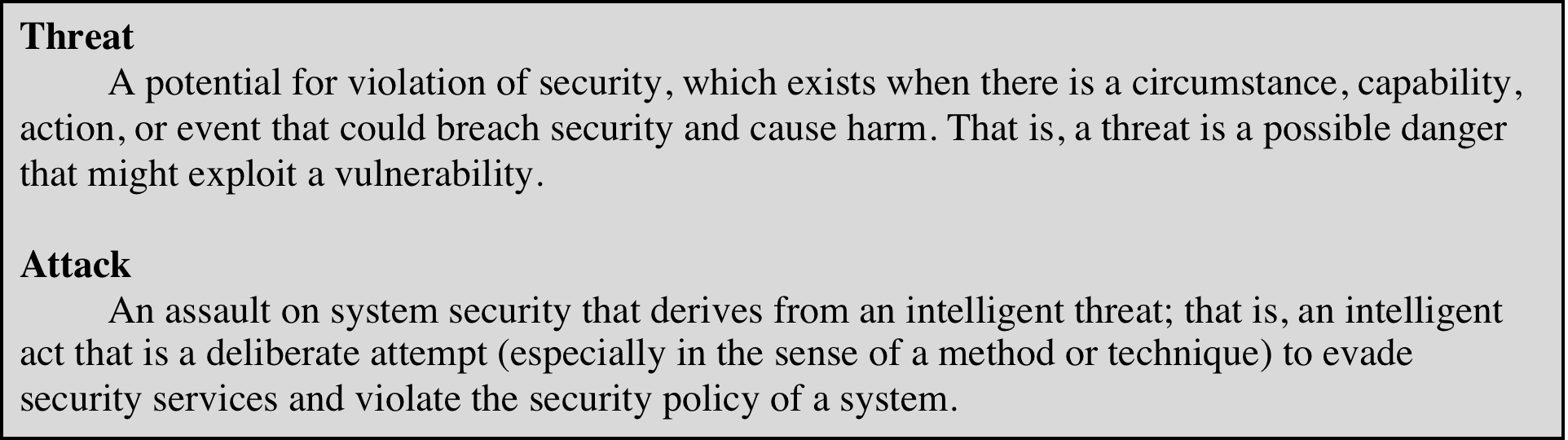
Threats and Attacks (RFC 4949)
Internet Security Glossary, Version 2
This Glossary provides definitions, abbreviations, and explanations of terminology for information system security.
Notes:
In the literature, the terms threat and attack are commonly used to mean more
or less the same thing. Table 1.1 provides definitions taken from RFC 4949, Internet
Security Glossary.

Slide 13
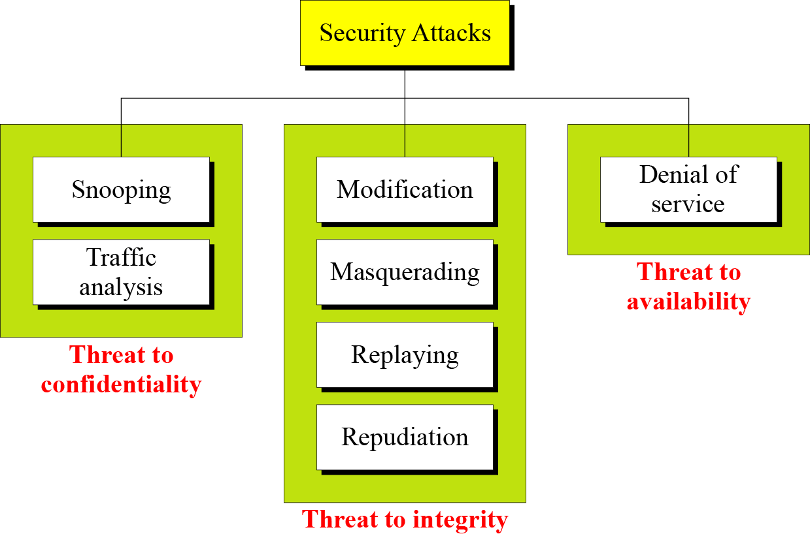

Slide 14
Passive Attacks (Two types)
Are in the nature of eavesdropping on, or monitoring of, transmissions
Goal of the opponent is to obtain information that is being transmitted
Two types of passive attacks are:
The release of message contents
Traffic analysis

Slide 15
Active Attacks (4 types)
Involve some modification of the data stream or the creation of a false stream
Difficult to prevent because of the wide variety of potential physical, software, and network vulnerabilities
Goal is to detect attacks and to recover from any disruption or delays caused by them

Slide 16
Modification means that the attacker intercepts the message and changes it.
Masquerading or spoofing happens when the attacker impersonates somebody else.
Replaying means the attacker obtains a copy of a message sent by a user and later tries to replay it.
Repudiation means that sender of the message might later deny that she has sent the message; the receiver of the message might later deny that he has received the message.

Slide 17
Denial of service (DoS) is a very common attack. It may slow down or totally interrupt the service of a system.

Slide 18
Security Services
to prevent or detect attacks
to enhance the security
replicate functions of physical documents
e.g.
have signatures, dates
need protection from disclosure, tampering, or destruction
notarize
record

Slide 19
Basic Security Services
Authentication
assurance that the communicating entity is the one it claims to be
peer entity authentication
mutual confidence in the identities of the parties involved in a connection
Data-origin authentication
assurance about the source of the received data
Access Control
prevention of the unauthorized use of a resource
to achieve this, each entity trying to gain access must first be identified and authenticated, so that access rights can be tailored to the individual

Slide 20
Basic Security Services
Non-Repudiation
protection against denial by one of the parties in a communication
Origin non-repudiation
proof that the message was sent by the specified party
Destination non-repudiation
proof that the message was received by the specified party

Slide 21
X.800 Service Categories
X.800 divides these services into five categories and fourteen specific services
Authentication
Access control
Data confidentiality
Data integrity
Nonrepudiation

Slide 22
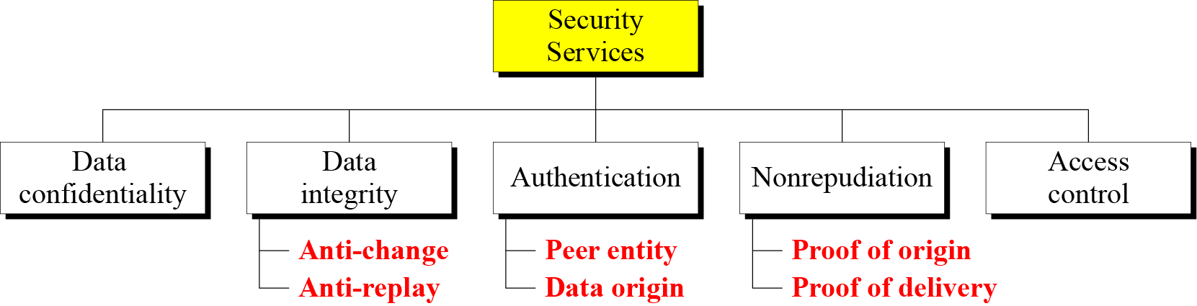

Slide 23
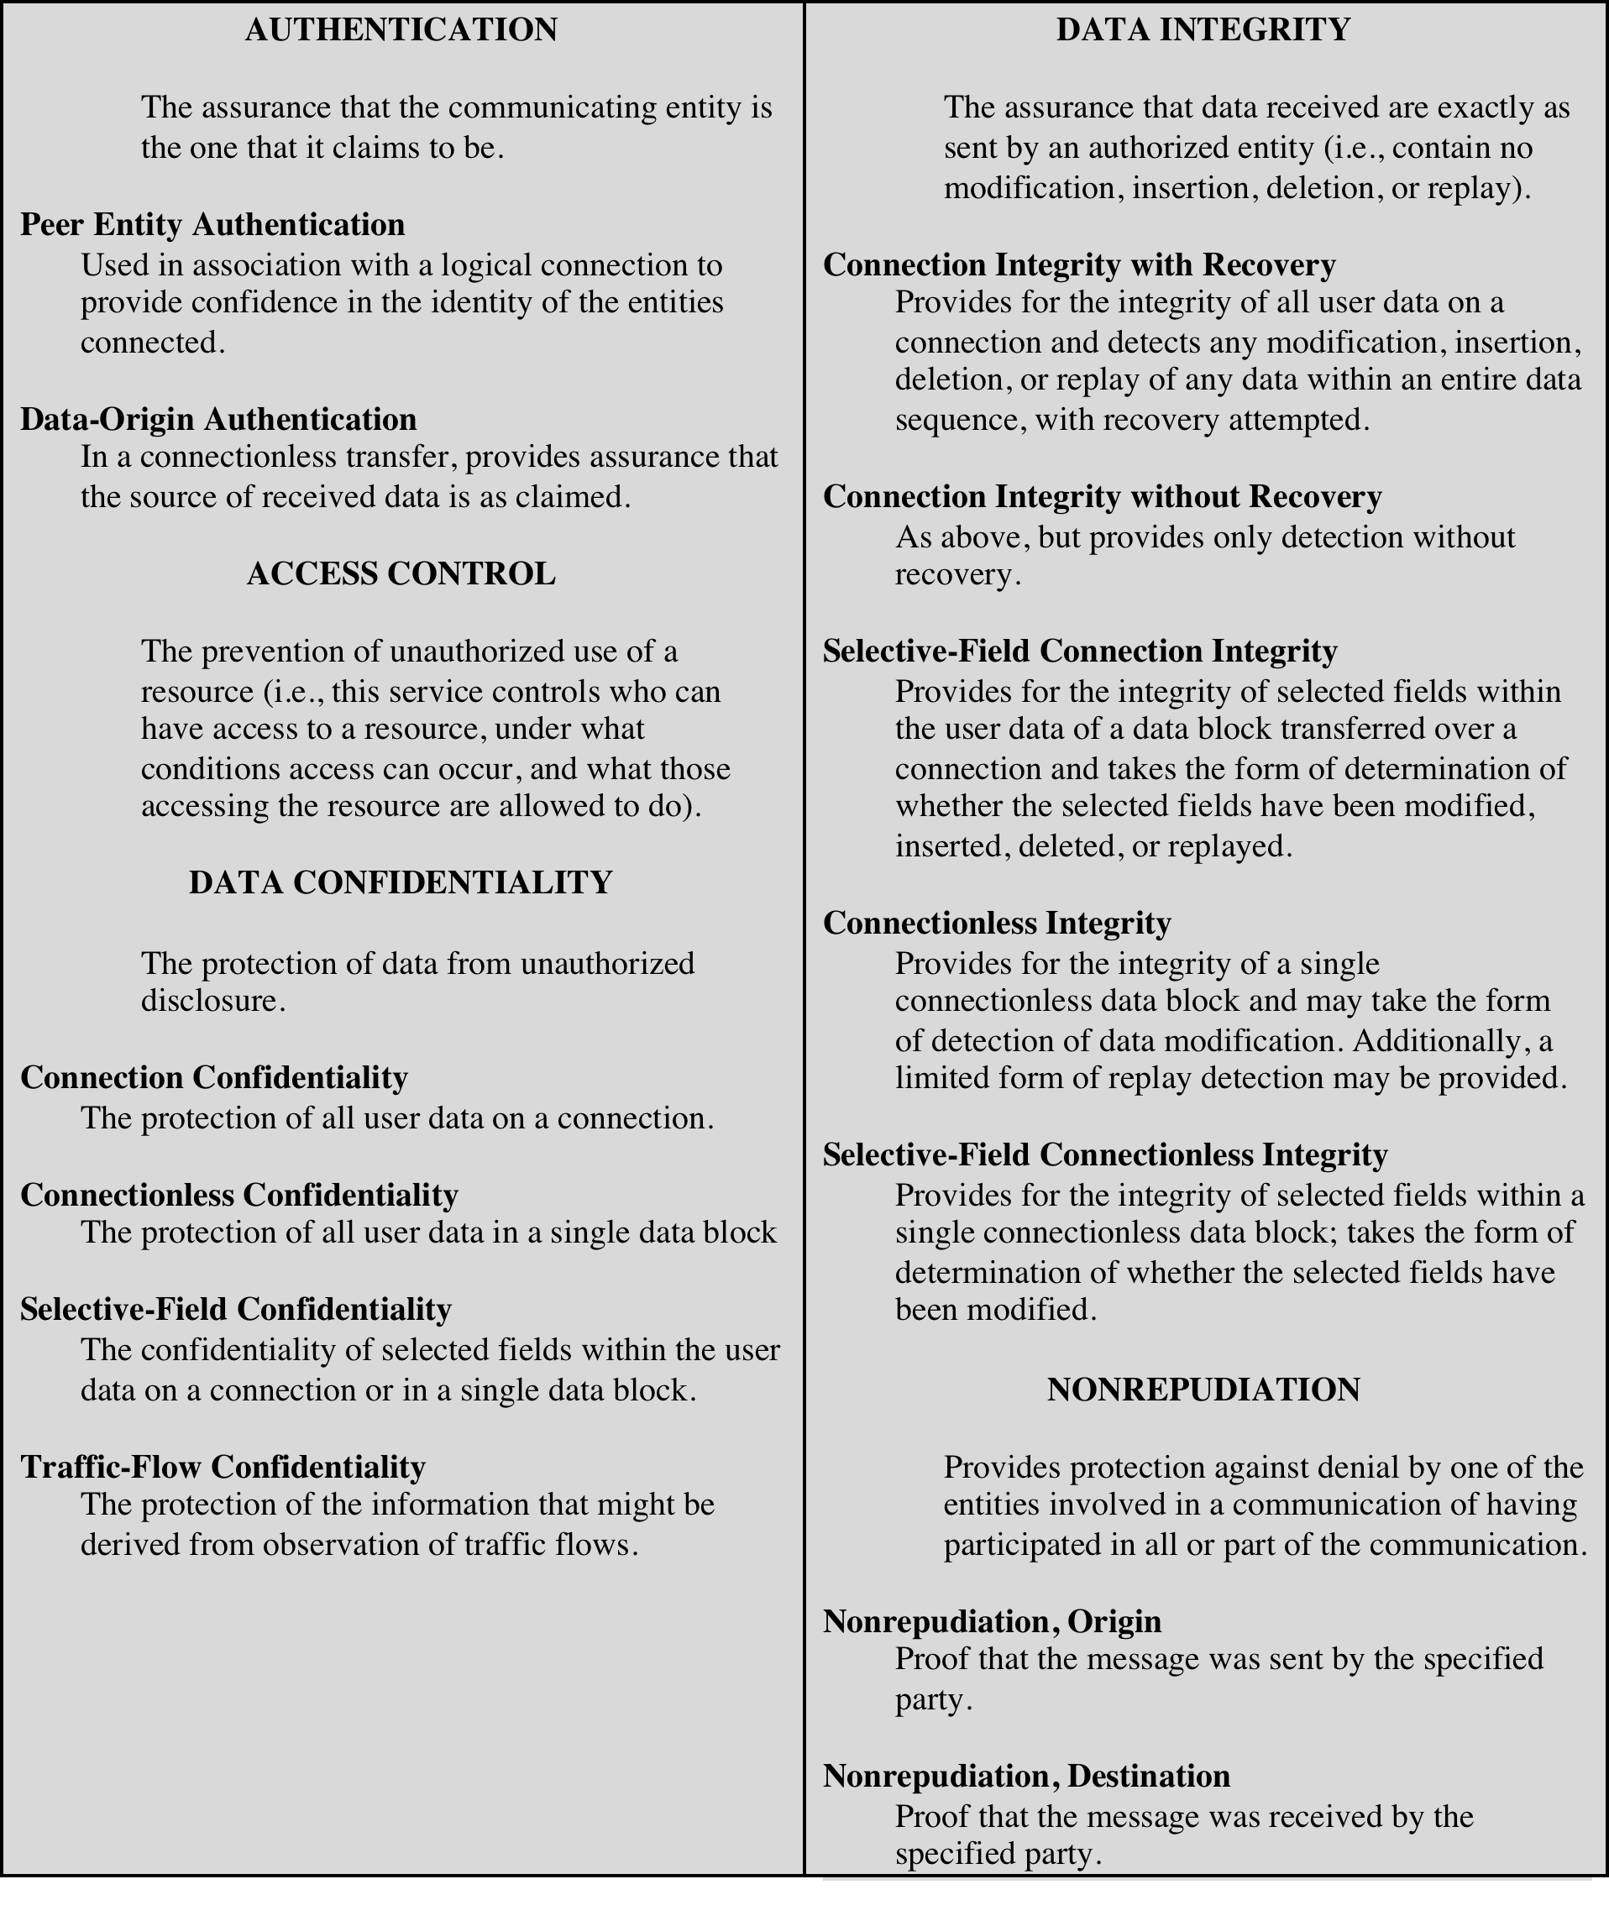
Security Services
(X.800)

Slide 24
Authentication
Concerned with assuring that a communication is authentic
In the case of a single message, assures the recipient that the message is from the source that it claims to be from.
In the case of ongoing interaction, assures the are authentic and that the connection is not interfered with in such a way that a third party can masquerade as one of the two legitimate parties
Two specific authentication services are defined in X.800:
Peer entity authentication
Data origin authentication
Two entities are considered peers if they implement the same protocol in different systems (e.g., two TCP modules in two communicating systems).

Slide 25
Access Control
The ability to limit and control the access to host systems and applications via communications links
To achieve this, each entity trying to gain access must first be identified, or authenticated, so that access rights can be tailored to the individual

Slide 26

Data Confidentiality
The protection of transmitted data from passive attacks
Broadest service protects all user data transmitted between two users over a period of time
Narrower forms of service include the protection of a single message or even specific fields within a message
The protection of traffic flow from analysis
This requires that an attacker not be able to observe the source and destination, frequency, length, or other characteristics of the traffic on a communications facility

Slide 27
Data Integrity
Can apply to a stream of messages, a single message, or selected fields within a message
Connection-oriented integrity service deals with a stream of messages and assures that messages are received as sent with no duplication, insertion, modification, reordering, or replays
A connectionless integrity service deals with individual messages without regard to any larger context and generally provides protection against message modification only

Slide 28

Nonrepudiation
Prevents either sender or receiver from denying a transmitted message
When a message is sent, the receiver can prove that the alleged sender in fact sent the message
When a message is received, the sender can prove that the alleged receiver in fact received the message

Slide 29
Availability service
Availability
The property of a system or a system resource being accessible and usable upon demand by an authorized system entity, according to performance specifications for the system
Availability service
One that protects a system to ensure its availability
Addresses the security concerns raised by denial-of-service attacks
Depends on proper management and control of system resources

Slide 30
Security Mechanisms
Cryptographic Techniques
will see next
Software and hardware for access limitations
Firewalls
Intrusion Detection and Prevention Systems
Traffic Padding
against traffic analysis
Hardware for authentication
Smartcards, security tokens
Security Policies / Access Control
define who has access to which resources.
Physical security
Keep it in a safe place with limited and authorized physical access

Slide 31
Cryptographic Security Mechanisms
Encryption (a.k.a. Encipherment)
use of mathematical algorithms to transform data into a form that is not readily intelligible
keys are involved

Slide 32
Cryptographic Security Mechanisms
Message Digest
similar to encryption, but one-way (recovery not possible)
generally no keys are used
Digital Signatures and Message Authentication Codes
Data appended to, or a cryptographic transformation of, a data unit to prove the source and the integrity of the data
Authentication Exchange
ensure the identity of an entity by exchanging some information

Slide 33
Security Mechanisms
Notarization
use of a trusted third party to assure certain properties of a data exchange
Timestamping
inclusion of correct date and time within messages

Slide 34
Security Mechanisms (X.800)
Specific security mechanisms: incorporated into the appropriate protocol layer in order to provide some of the OSI security services
Encipherment
digital signatures
access controls
data integrity
authentication exchange
traffic padding
routing control
notarization

Slide 35
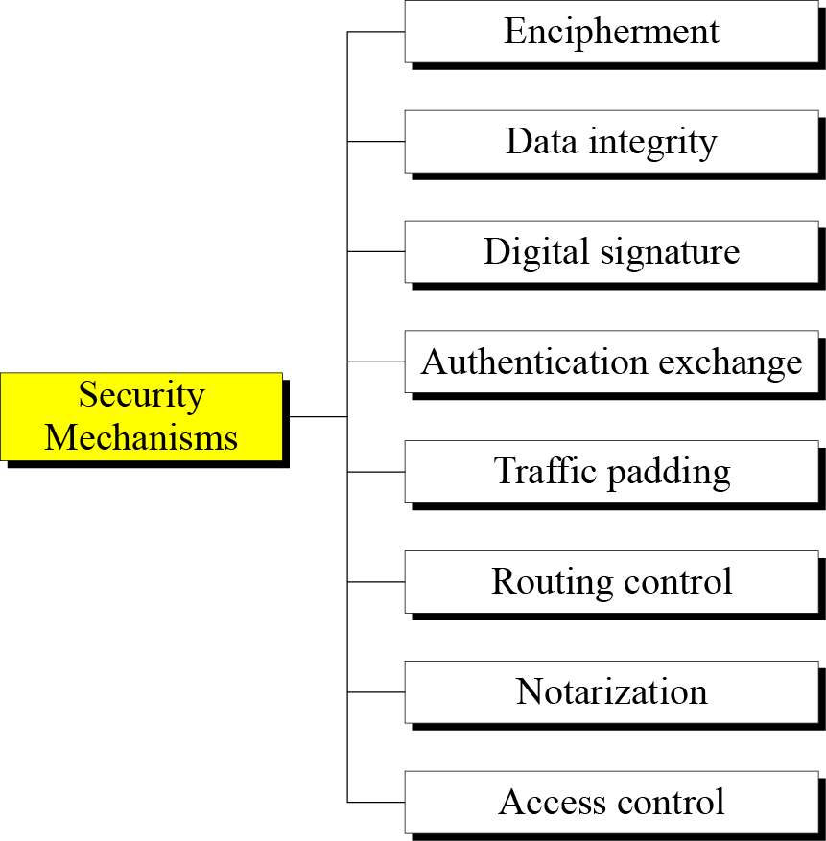

Slide 36
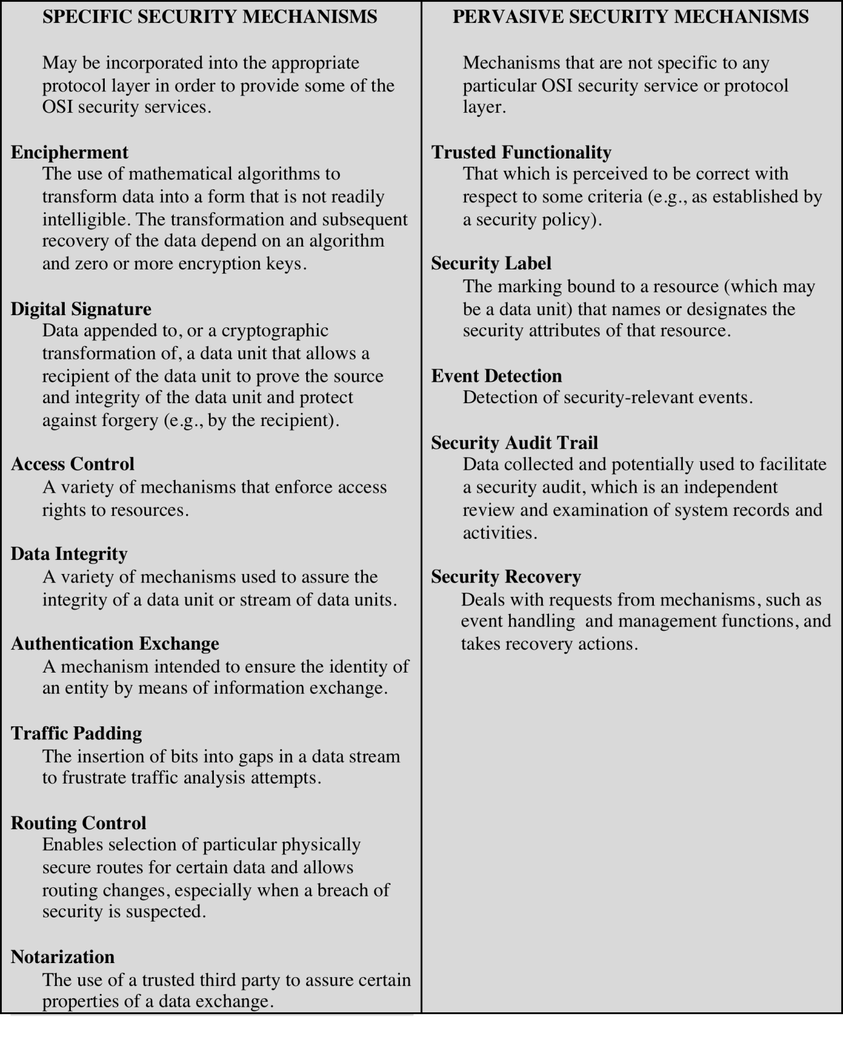
Security Mechanisms
(X.800)

Slide 37
Relationship Between Security Services and Mechanisms

Slide 38
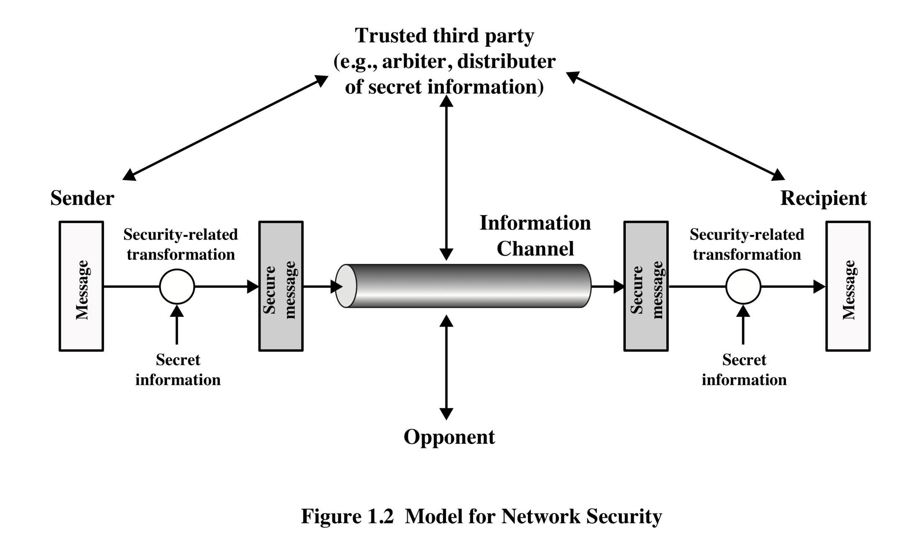
Model for Network Security

Slide 39
A Model for Network Security
Using this model requires us to:
Design a suitable algorithm for the security transformation
Generate the secret information (keys) used by the algorithm
Develop methods to distribute and share the secret information
Specify a protocol enabling the principals to use the transformation and secret information for a security service

Slide 40
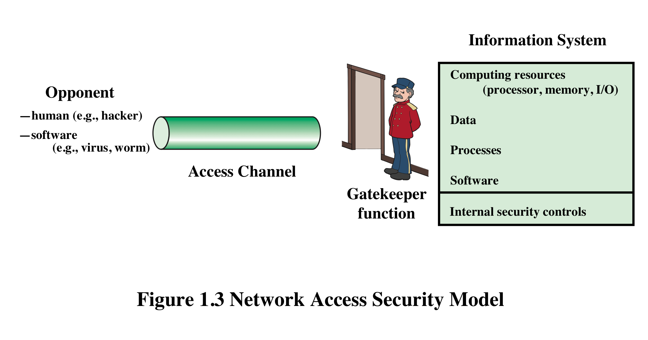
Network Access Security Model

Slide 41
A Model for Network Access Security
Using this model requires us to:
Select appropriate gatekeeper functions to identify users
Implement security controls to ensure only authorized users access designated information or resources

Slide 42
Attack Surfaces
An attack surface consists of the reachable and exploitable vulnerabilities in a system
Examples:
Open ports on outward facing Web and other servers, and code listening on those ports
Services available in a firewall
Code that processes incoming data, email, XML, office documents, etc.
Interfaces and Web forms
An employee with access to sensitive information vulnerable to a social engineering attack
Notes:
An attack surface consists of the reachable and exploitable vulnerabilities in a system
[MANA11, HOWA03]. Examples of attack surfaces are the following:
■ Open ports on outward facing Web and other servers, and code listening on
those ports
■ Services available on the inside of a firewall
■ Code that processes incoming data, email, XML, office documents, and industry-
specific custom data exchange formats
■ Interfaces, SQL, and Web forms
■ An employee with access to sensitive information vulnerable to a social
Engineering attack

Slide 43
Attack Surface Categories
Network attack surface
Refers to vulnerabilities over an enterprise network, wide-area network, or the Internet
E.g. DoS, intruders exploiting network protocol vulnerabilities
Software attack surface
Refers to vulnerabilities in application, utility, or operating system code
Human attack surface
Refers to vulnerabilities created by personnel or outsiders
E.g. social engineering, insider traitors
Notes:
Attack surfaces can be categorized as follows:
■ Network attack surface: This category refers to vulnerabilities over an enterprise
network, wide-area network, or the Internet. Included in this category are network
protocol vulnerabilities, such as those used for a denial-of-service attack,
disruption of communications links, and various forms of intruder attacks.
■ Software attack surface: This refers to vulnerabilities in application, utility,
or operating system code. A particular focus in this category is Web server
Software.
■ Human attack surface: This category refers to vulnerabilities created by
personnel or outsiders, such as social engineering, human error, and trusted
insiders.

Slide 44
Unwanted Access
Placement in a computer system of logic that exploits vulnerabilities in the system and that can affect application programs as well as utility programs
Programs can present two kinds of threats:
Information access threats
Intercept or modify data on behalf of users who should not have access to that data
Service threats
Exploit service flaws in computers to inhibit use by legitimate users

Slide 45
Cryptography
Cryptography, a word with Greek origins, means “secret writing.” However, we use the term to refer to the science and art of transforming messages to make them secure and immune to attacks.

Slide 46
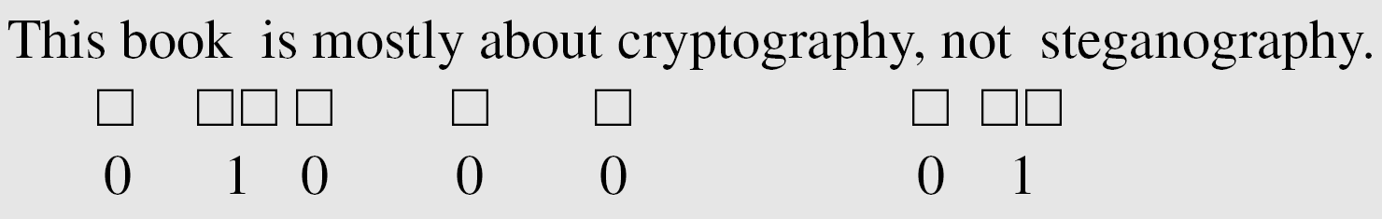
Steganography
The word steganography, with origin in Greek, means “covered writing,” in contrast with cryptography, which means “secret writing.”
Example: covering data with text

Slide 47
Example: using dictionary
Example: covering data under color image

Slide 48
Cryptographic Services
Cryptography supports the following services:
Confidentiality
2. Integrity
3. Authentication
4. Identity
5. Timeliness
6. Proof of ownership
Each has various different requirements in different circumstances, and each issupported by a wide variety of schemes.

